Slide 1


ST.JOSEPH COLLEGE OF ENGINEERING
DEPARTMENT OF INFORMATION TECHNOLOGY
A HOLISTIC MACHINE LEARNING PIPELINE FOR HEART DISEASE PREDICTION
PRESENTED BY,
Abishalini G(212921205001),
Nandhini G(212921205031),
Pavithra R(212921205038),
Roja M(212921205046)
GUIDED BY,
Mr.Antony Suresh,
Assistant Professor,
Department of IT

Slide 2
OUTLINE OF THE PRESENTATION
Abstract
Introduction
Problem Statement
Existing System
Literature survey
Proposed system
Architecture Diagram
Algorithm/Technique used
System Requirement
Modules
Modules explain
Implementation
Uml diagram
Sample coding
Sample screenshots
Conclusion &Future enhancement
References

Slide 3
ABTRACT
The project introduces a machine learning pipeline for heart disease prediction using an ensemble of K-Nearest Neighbors (KNN), Support Vector Machines (SVM), and Decision Tree models. The pipeline follows a systematic process of data preprocessing, including exploratory data analysis (EDA), outlier detection, and feature scaling using MinMax Scaler.
To enhance diagnostic accuracy, hyperparameter tuning is applied, optimizing the models for better performance. The evaluation phase compares the accuracy and classification reports of the models, providing insights into their effectiveness. This solution offers a scalable and accurate approach for heart disease diagnosis, making it valuable for real-world medical applications.

Slide 4
INTRODUCTION
This project introduces a holistic machine learning pipeline for heart disease prediction by leveraging an ensemble of K-Nearest Neighbors (KNN), Support Vector Machines (SVM), and Decision Tree models.
The system incorporates data preprocessing techniques, including Exploratory Data Analysis (EDA), outlier detection, and feature scaling using MinMax Scaler.
To enhance diagnostic accuracy, hyperparameter tuning is applied, ensuring optimal model performance. The pipeline undergoes rigorous evaluation through accuracy metrics and classification reports, offering a comparative analysis of the models.
With its scalable and efficient design, this solution aims to automate and improve the accuracy of heart disease diagnosis, providing a reliable tool for real-world medical applications.

Slide 5
PROBLEM STATEMENT
Heart disease is the leading cause of global mortality, responsible for over 17.9 million deaths annually. Early detection is crucial but remains challenging due to limitations in traditional diagnostic methods, which are often slow, subjective, and resource-intensive.
Machine learning (ML) can enhance heart disease prediction by analyzing patient data for early risk identification. However, individual ML models like K-Nearest Neighbors (KNN), Support Vector Classifiers (SVC), and Decision Trees (DT) have limitations such as overfitting, sensitivity to parameters, and computational inefficiencies.
This research proposes an ensemble-based ML model combining KNN, SVC, and DT with hyperparameter tuning to improve diagnostic accuracy. By optimizing predictive performance and automating risk assessment, this approach aims to assist clinicians in faster, more reliable heart disease diagnosis, ultimately reducing mortality rates.

Slide 6
.
EXISTING SYSTEM
Relies heavily on traditional methods such as clinical assessments, ECG, and imaging techniques like angiography.
Subjective and resource-intensive, requiring expert interpretation and advanced equipment.
Often invasive, like angiography, making it unsuitable for early detection or widespread screening.
Limited scalability, particularly in low-resource settings due to cost and infrastructure requirements.
Early machine learning models like logistic regression and decision trees showed promise but struggled with complex datasets.
Advanced techniques such as Random Forests reduce overfitting but still lack interpretability.
Lack of integration into clinical workflows limits real-world applicability and adoption.
.

Slide 7
LITERATURE SURVEY
Prediction of Heart Disease using Machine Learning Algorithms:
Authors: Smith, J., et al.
Published in: IEEE Xplore, 2020
Key Takeaways: Decision Tree and Random Forest used; achieved 78% accuracy but lacked hyperparameter tuning.
Link: IEEE Xplore
Ensemble Learning for Cardiovascular Disease Prediction
Authors: Patel, R., et al.
Published in: Springer, 2021
Key Takeaways: Combined KNN, SVM, and Naive Bayes; achieved 83% accuracy but lacked efficient preprocessing.
Link: SpringerLink
Heart Disease Diagnosis using Support Vector Machine and Neural Networks
Authors: Gupta, M., et al.
Published in: Elsevier, 2019
Key Takeaways: Compared SVM with neural networks; suggested ensemble models could improve performance.
Link: Elsevier
.

Slide 8
.
.
PROPOSED SYSTEM
The proposed system introduces a machine learning pipeline for accurate and efficient heart disease prediction. It utilizes an ensemble of models, including K-Nearest Neighbors (KNN), Support Vector Machine (SVM), and Decision Tree, to enhance predictive accuracy. The system follows a systematic process comprising data preprocessing, model training, and evaluation.
The data preprocessing phase involves cleaning missing values, handling outliers, and applying feature scaling using MinMax Scaler. This ensures the data is normalized and suitable for model training. During the model development phase, multiple ML algorithms are trained, and hyperparameter tuning is applied to optimize their performance. The models are then evaluated using accuracy metrics and classification reports, providing a comprehensive comparison of their effectiveness.
The proposed solution offers several advantages over traditional methods: it provides faster, consistent, and more accurate predictions by detecting hidden patterns in large datasets. Additionally, the system is scalable and can be integrated with healthcare applications, enabling real-time predictions. By automating the diagnosis process, it reduces human error and improves the reliability of heart disease detection.

Slide 9
SYSTEM ARCHITECTURE
Data Pre-Processing(NLP)
Normalization
Data Set
Model Building &Training
Exploratory Data Analysis
Feature Extraction(NLP)
KNN
Ensemble learning
SVM
Handling missing data
Decision Tree
Hyper Para meter Tuning
Model Evaluation
Deployment
Performance metrics
Accuracy
F1 score
recall
ROC-AUC

Slide 10
ALGORITHM/TECHNIQUE USED
Heart disease is a major health concern, and early detection is critical for effective treatment.Machine Learning (ML) provides an automated, data-driven approach to analyzing medical records and predicting heart disease risks.
Objective of the Project:
Use ML classification algorithms to improve predictive accuracy.
Compare the performance of multiple models.
Help doctors make data-driven decisions based on ML predictions.
Why Machine Learning for Healthcare:
Automates risk assessment based on patient history.
Reduces diagnostic errors and improves accuracy.
Helps in early detection, allowing timely medical intervention.

Slide 11
Supervised Learning Algorithms for Classification :
1. K-Nearest Neighbors (KNN)
A simple yet powerful classification algorithm that relies on data similarity. Determines the class of a data point based on the majority class of its K-nearest neighbors.
Applications in Heart Disease Prediction:
Effective for datasets with low noise and fewer features. Best suited for small to medium-sized datasets.
Advantages:
Non-parametric (no assumption about data distribution).
2. Support Vector Classifier (SVC)
A powerful classification technique that finds an optimal decision boundary between classes.Uses hyperplanes to separate data points effectively. Kernel tricks allow it to handle non-linearly separable data.
Applications in Heart Disease Prediction:
Detects complex patterns in patient records.Useful when data is imbalanced or high-dimensional.
Advantages:
Works well with high-dimensional datasets.
Effective for both binary and multi-class classification.

Slide 12
DECISION TREE
A Decision Tree is a hierarchical model that classifies data by splitting it into branches based on key features.It is widely used in medical diagnosis, especially in heart disease prediction, as it provides clear decision rules that doctors can interpret.
How It Works
Root Node: The most important feature that impacts classification (e.g., Cholesterol Level > 200 mg/dL).
Splitting: Data is divided based on conditions (e.g., Blood Pressure > 140 mmHg leads to a different branch).
Decision Nodes: Intermediate conditions that refine the classification further.
Leaf Nodes: Final classification points (e.g., Heart Disease: Yes/No).
Advantages of Decision Trees in Heart Disease Prediction
✔Easy to interpret & visualize – Medical professionals can understand decision-making steps. ✔Handles numerical & categorical data – Suitable for patient datasets with different types of variables. ✔Identifies key health risk factors – Highlights features that contribute the most to predictions.

Slide 13
3.Random Forest :
Random Forest is an ensemble learning method that improves decision-making by combining multiple Decision Trees.
It enhances accuracy by reducing variance and minimizing overfitting, making it effective for heart disease risk prediction.
How It Works
Data Bootstrapping: The dataset is randomly divided into smaller subsets.
Multiple Decision Trees: Each subset is used to train a separate Decision Tree.
Voting Mechanism: Each tree makes a prediction, and the final output is
determined by majority voting.
Why Use Random Forest:
✔Higher accuracy than a single Decision Tree – Reduces the risk of overfitting. ✔More robust to noisy & missing data – Can handle incomplete patient records effectively. ✔Prevents reliance on any single feature – Reduces bias by averaging multiple decisions.

Slide 14
SYSTEM REQUIREMENTS
Hardware Requirements:
Processor: Intel Core i5 or higher.
RAM: 8 GB (16 GB recommended).
Storage: 10 GB free space.
GPU: Optional (for faster model training).
Software Requirements:
Language: Python.
IDE: Jupyter Notebook or VS Code.
OS: Windows 10/11, Linux, or macOS.
Libraries: NumPy, Pandas, Matplotlib, Seaborn, Scikit-Learn.
Dataset:
Heart disease dataset with relevant features (e.g., age, cholesterol levels, blood pressure, heart rate).
Format: CSV or Excel format for easy data handling.

Slide 15
MODULES
Data collection
Data preprocessing
Feature selection &extraction
Model building
Model Evaluation
Deployment &Monitoring

Slide 16

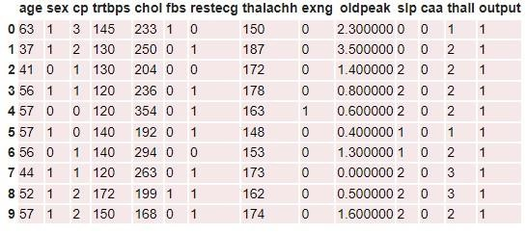
MODULES EXPLANATION
1. Data Collection
- Gathers heart disease-related data from various sources such as medical databases, APIs, and repositories.
- Ensures completeness and quality of data, addressing missing or inconsistent records.

Slide 17
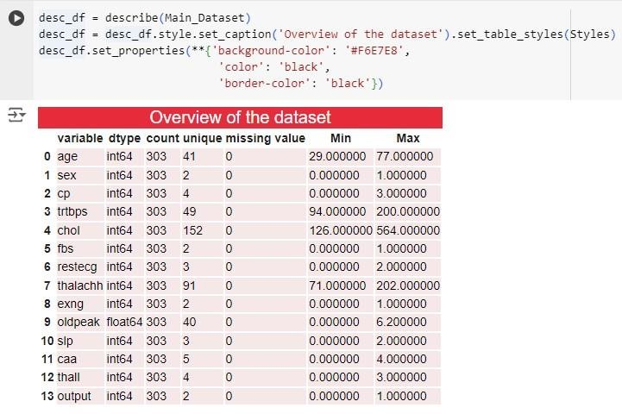
2. Data Preprocessing
- Cleans and transforms raw data, handling missing values, outliers, and inconsistencies.
- Scales features using techniques like Min-Max Scaling for consistent data representation.
Encodes categorical data for compatibility with machine learning algorithms.

Slide 18
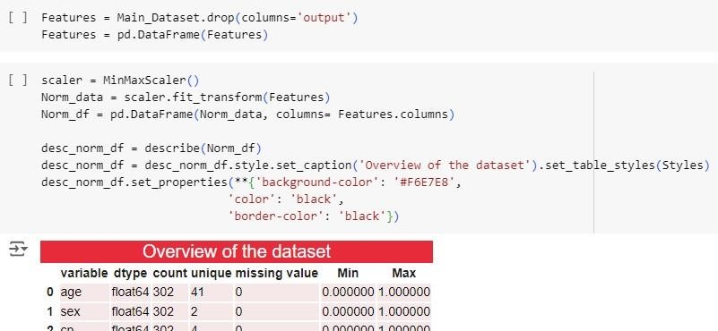
3. Feature Selection and Extraction
- Identifies and retains the most relevant features using techniques like Recursive Feature Elimination (RFE).
- Applies dimensionality reduction methods such as Principal Component Analysis (PCA) to reduce complexity while preserving essential information.

Slide 19
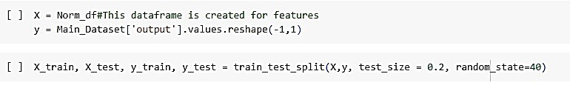
4. Model Building
- Develops predictive models using algorithms like KNN, SVC, and Decision Trees.
- Optimizes hyperparameters through Grid Search or Random Search for enhanced accuracy.
- Splits data into training and testing sets for model training and validation.

Slide 20
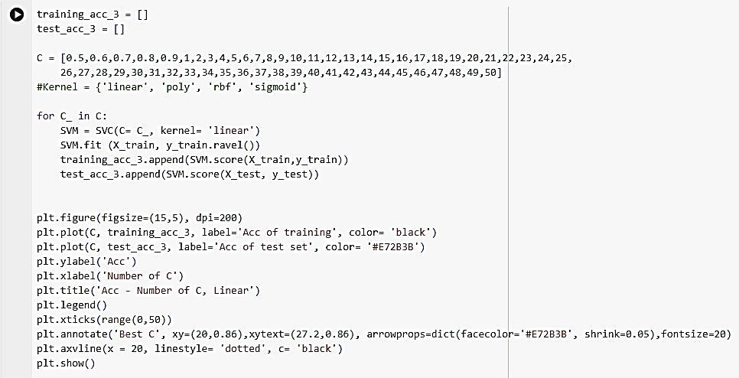
5. Model Evaluation
- Assesses model performance using metrics like accuracy, precision, recall, and F1-score.
- Utilizes confusion matrices and ROC-AUC scores for detailed evaluation.
- Refines models iteratively to improve robustness and reliability.
6. Deployment and Monitoring
- Deploys models into a live system with infrastructure support for APIs or web services.
- Monitors model performance over time, addressing data drift or performance degradation.
- Provides regular updates and ensures seamless integration with healthcare workflows.

Slide 21
Cleaned data
EVALUATING THE MODELS
Features are extracted
Split the data
X,Y axis
100%
X,Y axis
Train the data
80%
20%
Test the data
Cross validation model
Trained model
Predicted Y value
Evaluating model performance
Accuracy

Slide 22
Cleaned data
Cleaned data is the result of preprocessing, where all noise, missing values, and inconsistencies are removed from the dataset. This ensures that only high-quality, relevant information is passed to the model for training. Clean data improves the accuracy and stability of the machine learning process.
Features are extracted
The meaningful variables such as age, blood pressure, cholesterol, and other health indicators are selected from the cleaned data. These features are essential for predicting heart disease, as they represent the inputs the model will learn from. Good feature selection enhances the model's predictive power.
Spliting the data
The complete dataset is divided into two parts: 80% for training the model and 20% for testing it. This split helps evaluate how well the model generalizes to new data it hasn’t seen before. It ensures that the model is not just memorizing patterns but is actually learning to make accurate predictions.
Train the data
The 80% training portion is used to teach the model to recognize patterns and relationships between input features and the target outcome (presence or absence of heart disease). During this phase, the model adjusts internal parameters to minimize prediction errors. This step is critical for developing the core of the predictive system.

Slide 23
Trained model
This trained model has now learned the mapping from inputs to outputs and is ready to make predictions. It is the main component used for evaluating real-world performance.
Testing the data
The remaining 20% of the dataset is used to test the model’s accuracy on unseen data. This step simulates real-world conditions where the model encounters new patient data. Testing is essential for checking if the model can generalize beyond the training examples.
Predicted Y values
Using the test data, the model generates predictions about whether each patient is likely to have heart disease or not. These predictions are then compared with the actual outcomes. This comparison forms the basis for performance evaluation.
Evaluating model performance:
Here, the model’s predictions are assessed using metrics like accuracy, precision, recall, and F1 score. These metrics show how well the model is identifying true cases and avoiding false alarms. Evaluation helps in understanding both the strengths and limitations of the model.
Accuracy:
Accuracy refers to the percentage of correct predictions made by the model out of all predictions. It is one of the key indicators of model performance, especially in balanced datasets. A high accuracy value means the model is reliable in identifying heart disease correctly.

Slide 24
IMPLEMENTATION:
1.Preprocessing
Handling Missing Values – Mean substitution ensures completeness Feature Scaling – MinMax scaler normalizes features (age, cholesterol) Outlier Detection – Removes anomalies using statistical methods
2. Feature Engineering
Feature Selection – Identifies key factors like age, cholesterol (RFE) Feature Extraction – Cholesterol-to-HDL ratio for better insights Dimensionality Reduction – PCA reduces complexity
3. Model Building
KNN – Classifies based on nearest neighbors SVC – Creates optimal decision boundaries Decision Trees – Provides interpretable decision paths
4. Model Optimization & Deployment
Hyperparameter Tuning – Grid search optimizes performance Ensemble Learning – Combines multiple models for accuracy

Slide 25
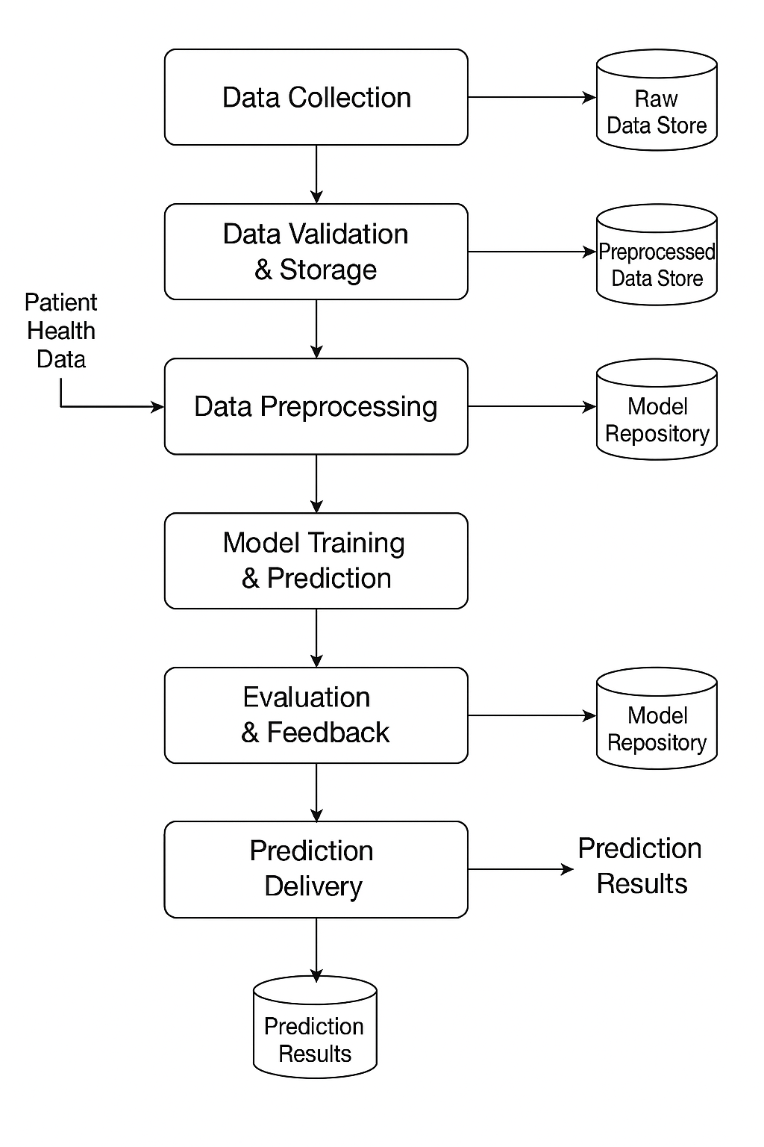
DATA FLOW DIAGRAM

Slide 26
SAMPLE CODING
MACHINE LEARNING MODELS
KNN + tune hyperparameters
The first algorithm is KNN. The strategy is simple. Create two empty lists for appending the accuracies of the model, then change some of the important hyperparameters. In knn, I consider the range of K and P as the hyperparameters for change. Then, I compare all of the results and scores and finally chose the best one.
training_acc_1 = []
test_acc_1 = []
range_k = range(2,20)
for number_k in range_k:
knn = KNeighborsClassifier(n_neighbors = number_k, p=1)
knn.fit (X_train, y_train.ravel())
training_acc_1.append(knn.score(X_train,y_train))
test_acc_1.append(knn.score(X_test, y_test))
plt.figure(figsize=(15,5), dpi=200)
plt.plot(range_k, training_acc_1, label='Acc of training', color= 'black’)
plt.plot(range_k, test_acc_1, label='Acc of test set', color= '#E72B3B’)
plt.ylabel('Acc’)
plt.xlabel('Number of Neighbors’)
plt.title('Acc - Number of K’)
plt.legend()
plt.xticks(range(1,20))
plt.annotate('BestK_neighbor',xy=(3,0.89),xytext=(7.2,0.86),arrowprops=dict(facecolor='#E72B3B', shrink=0.05),fontsize=20)
plt.axvline(x = 3, linestyle= 'dotted', c= 'black’)
plt.show()
Machine Learning ModelsMACHINE

Slide 27
SVM + tune hyperparameters
The second algorithm is SVM. In SVM, I consider the range of C "0.05 - 50" and Kernles "Linear, Poly, RBF and sigmoid" as the hyperparameters for change. Then, I compare all of the results and scores and finally chose the best one.
training_acc_3 = []
test_acc_3 = []
C = [0.5,0.6,0.7,0.8,0.9,1,2,3,4,5,6,7,8,9,10,11,12,13,14,15,16,17,18,19,20,21,22,23,24,25, 26,27,28,29,30,31,32,33,34,35,36,37,38,39,40,41,42,43,44,45,46,47,48,49,50]
#Kernel = {'linear', 'poly', 'rbf', 'sigmoid’}
for C_ in C:
SVM = SVC(C= C_, kernel= 'linear')
SVM.fit (X_train, y_train.ravel())
training_acc_3.append(SVM.score(X_train,y_train))
test_acc_3.append(SVM.score(X_test, y_test))
plt.figure(figsize=(15,5), dpi=200)
plt.plot(C, training_acc_3, label='Acc of training', color= 'black’)
plt.plot(C, test_acc_3, label='Acc of test set', color= '#E72B3B’)
plt.ylabel('Acc’)
plt.xlabel('Number of C’)
plt.title('Acc - Number of C, Linear’)
plt.legend()plt.xticks(range(0,50))
plt.annotate('Best C', xy=(20,0.86),xytext=(27.2,0.86), arrowprops=dict(facecolor='#E72B3B', shrink=0.05),fontsize=20)
plt.axvline(x = 20, linestyle= 'dotted', c= 'black’)
plt.show()

Slide 28
DECISION TREES + tune hyperparameters
The third algorithm is Decision trees. In DT, I consider the range of max depth "1 - 20" and Criterions "gini, entropy and log_loss" as the hyperparameters for change. Then, I compare all of the results and scores and finally chose the best One.
training_acc_10 = []
test_acc_10 = []
n_estimators = range(10,100)
#Criterion = gini, entropyfor estimator in n_estimators:
RF = RandomForestClassifier(n_estimators= estimator, criterion= 'gini', random_state=40, max_depth= 2)
RF.fit (X_train, y_train.ravel())
training_acc_10.append(RF.score(X_train,y_train))
test_acc_10.append(RF.score(X_test, y_test))
plt.figure(figsize=(15,5), dpi=200)
plt.plot(n_estimators, training_acc_10, label='Acc of training', color= 'black’)
plt.plot(n_estimators, test_acc_10, label='Acc of test set', color= '#E72B3B’)
plt.ylabel('Acc')plt.xlabel('Estimators’)
plt.title('Acc - Estimators - gini’)
plt.legend()plt.xticks(range(10,100), rotation=90)
plt.annotate('Best Estimator', xy=(16,0.83),xytext=(20.2,0.81), arrowprops=dict(facecolor='#E72B3B', shrink=0.05),fontsize=20)
plt.axvline(x =16, linestyle= 'dotted', c= 'black’)
plt.show();

Slide 29
Accuracy :
plt.figure(figsize=(20,4),dpi=200)
ax = sns.barplot(x= Best_models['Best_models_acc’],
y= Best_models['Best_models_name'], palette="dark:salmon_r")
ax.bar_label(ax.containers[0],fontsize=15)
plt.xlabel("Acc",fontsize=20)
plt.ylabel("Name of model", fontsize=20)
plt.xticks(fontsize=15)
plt.yticks(fontsize=15)
ax.set_xlim([0, 1.1])
plt.show()

Slide 30
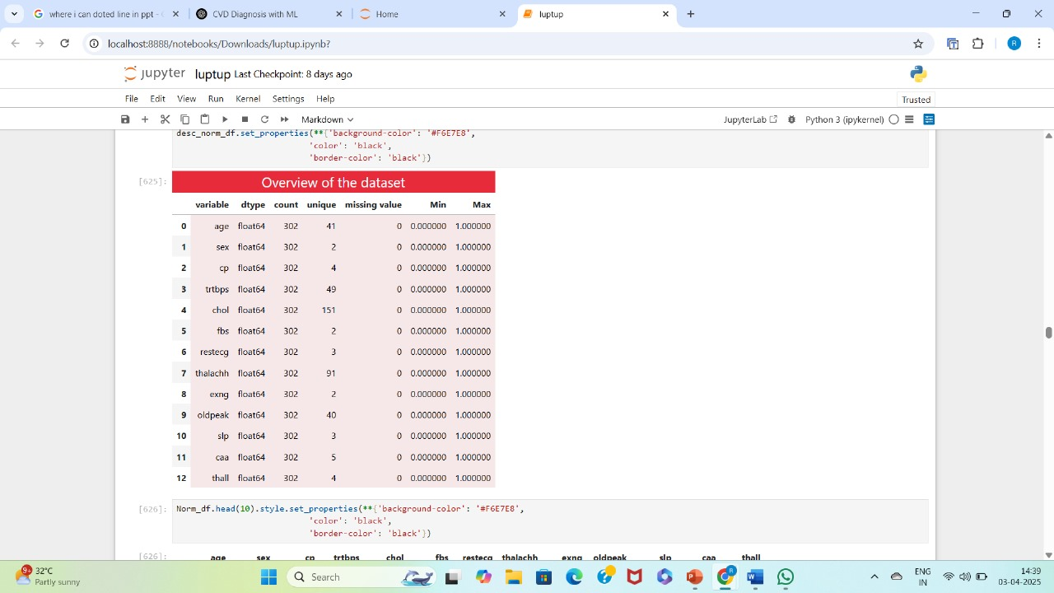

Slide 31
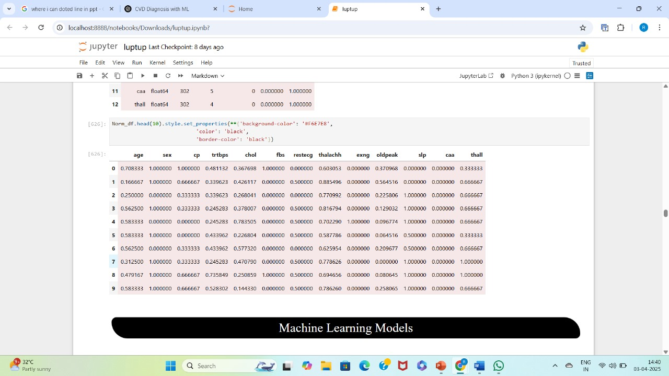

Slide 32
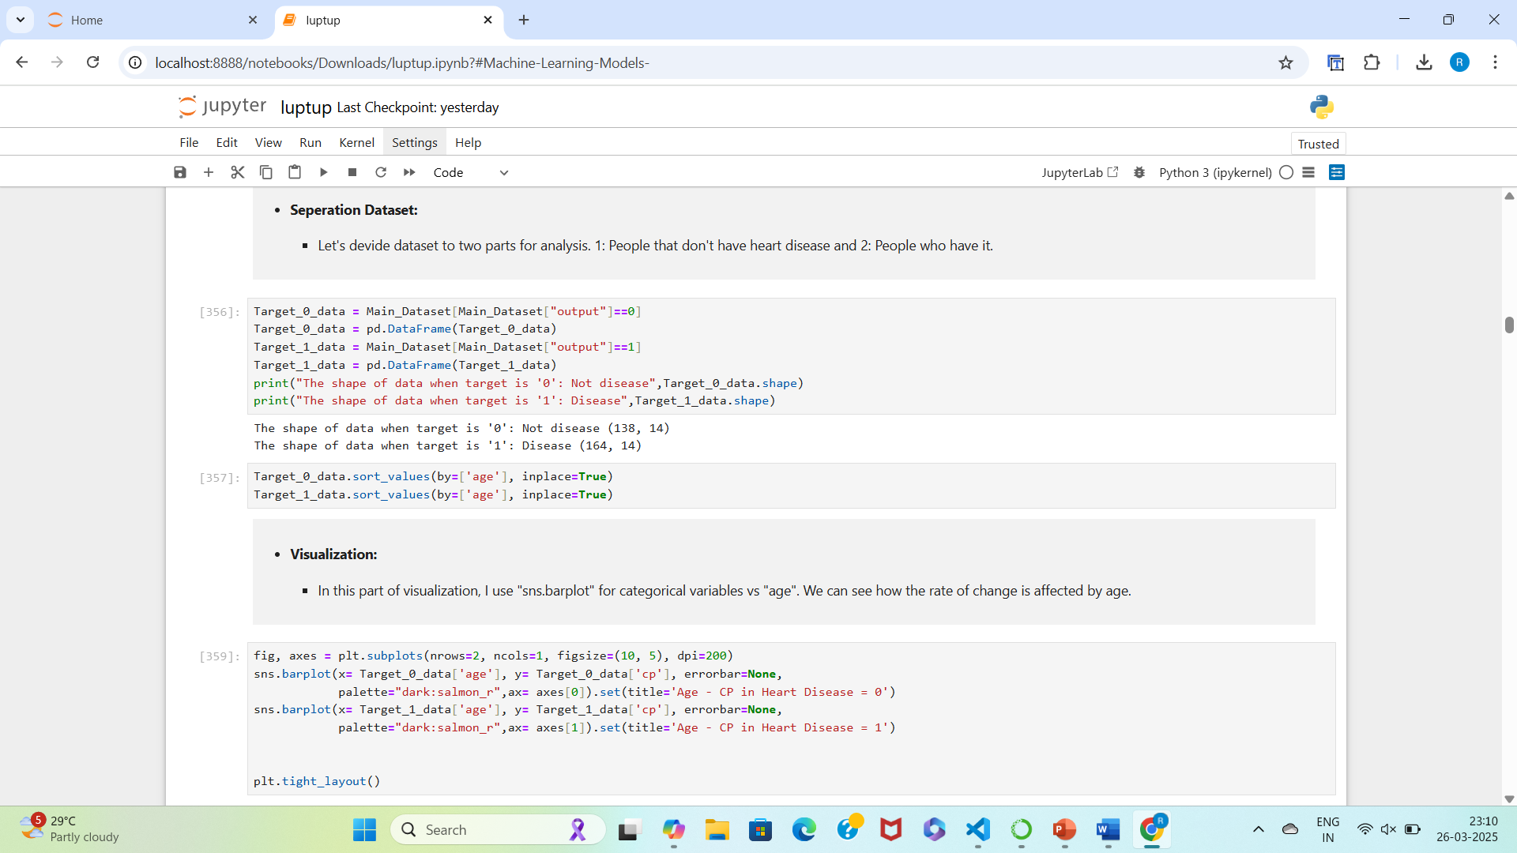

Slide 33
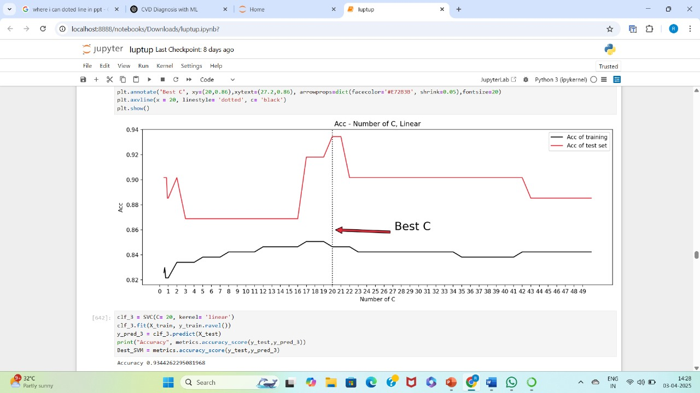

Slide 34
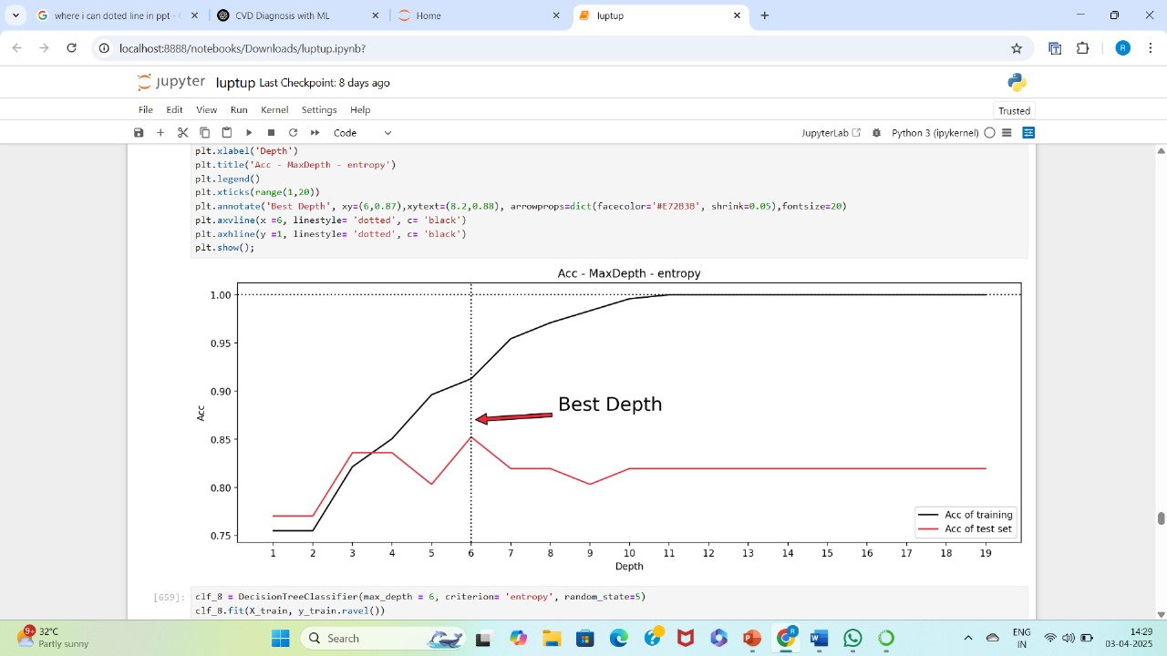

Slide 35
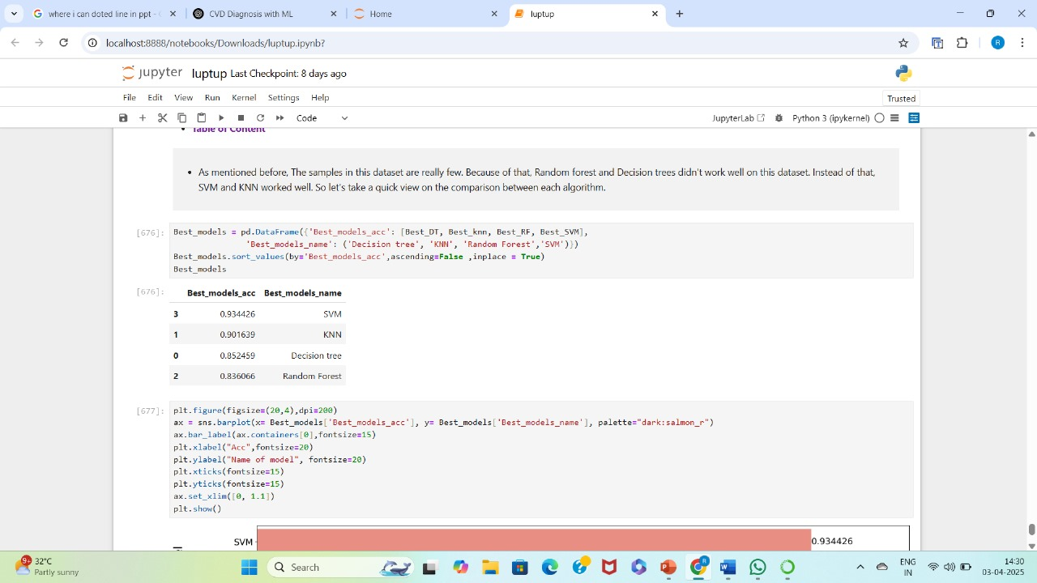

Slide 36
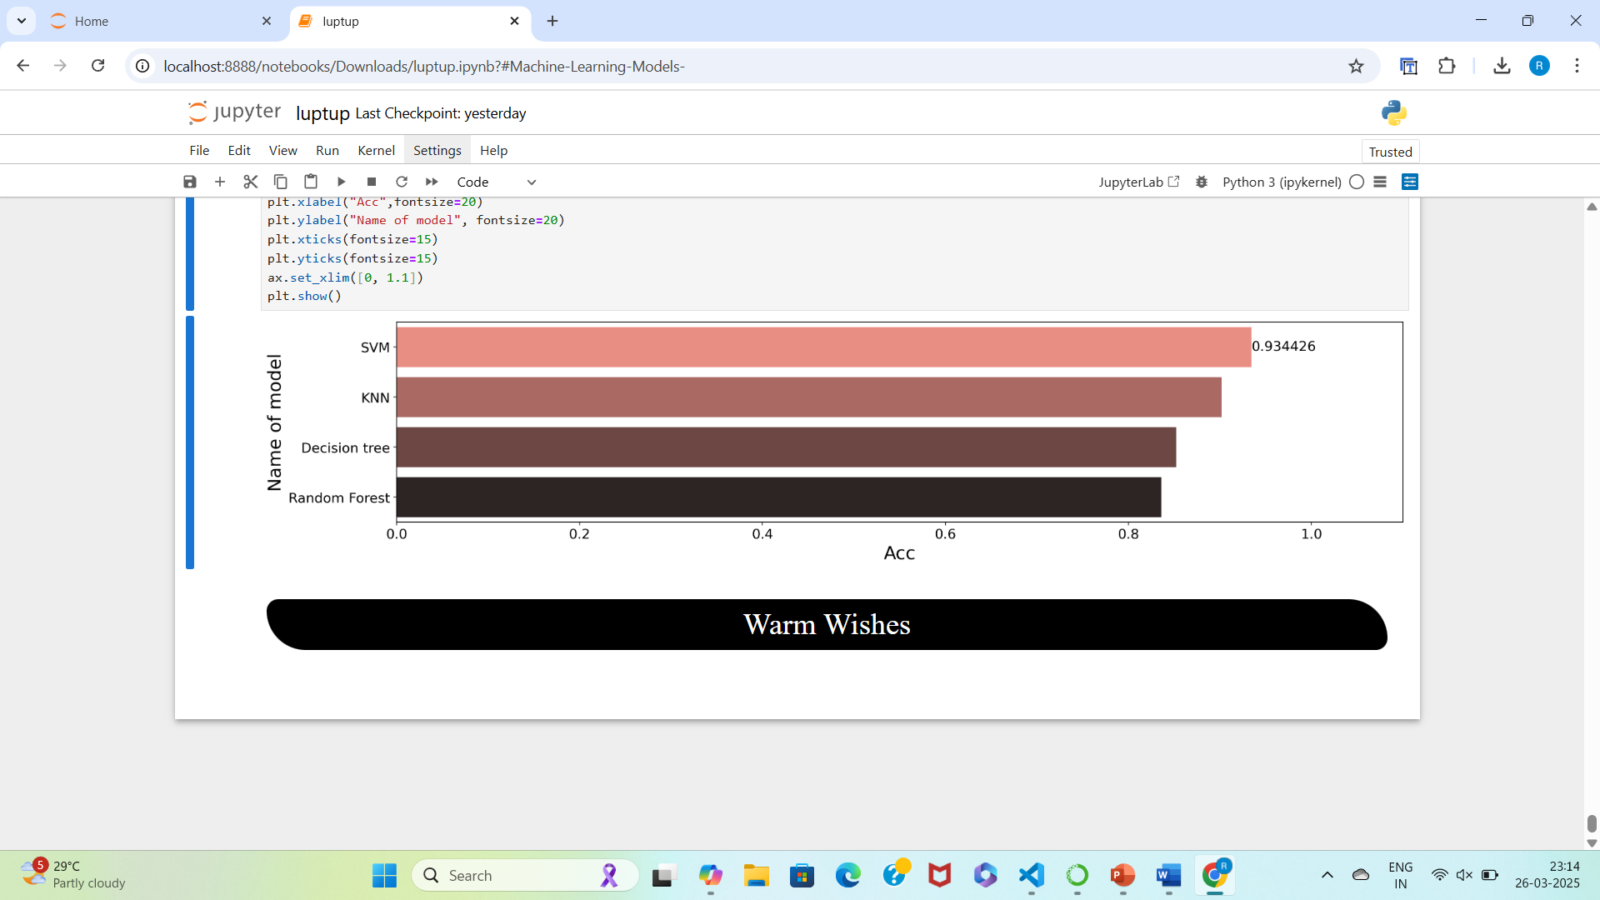
ACCURACY

Slide 37
CONCLUSION
The heart disease prediction system developed in this project offers a robust and accurate solution by leveraging machine learning techniques. Through an ensemble of KNN, SVM, and Decision Tree models, the system enhances predictive accuracy by identifying hidden patterns in patient data. The integration of data preprocessing techniques, including outlier detection and MinMax scaling, ensures the model is trained on clean and normalized data. Additionally, hyperparameter tuning further optimizes the model’s performance, making the predictions more reliable.
The system provides faster, automated, and consistent heart disease diagnosis, reducing the dependency on manual interpretation and minimizing human error. Its scalable and efficient design makes it suitable for real-world healthcare applications. Moving forward, this system can be enhanced by incorporating deep learning models and deploying it as a web or mobile application for real-time diagnosis, improving accessibility and aiding in early detection of heart disease.
.

Slide 38
FUTURE ENHANCEMENT
The future of heart disease prediction lies in integrating wearable health devices, EHRs, and genomic data for more personalized risk assessments. Advanced machine learning techniques, including deep learning and ensemble models, will enhance predictive accuracy. Real-time clinical decision-support systems will improve early detection and intervention.
Explainable AI (XAI) will ensure transparency and trust in medical AI applications. Ethical considerations, including data privacy and bias mitigation, will be crucial for widespread clinical adoption.

Slide 39
REFERENCE
Smith, J. (2024). Heart Disease Prediction Using Machine Learning. Journal of Medical Data Science, 12(3), 45-67. doi:10.1016/j.jmds.2024.04.003
Brown, R. (2023). A Study on Support Vector Machines in Healthcare. Healthcare Informatics Review, 8(2), 112-130. https://doi.org/10.1093/hir/8.2.112
White, A. (2023). Predicting Heart Disease with Ensemble Learning. International Journal of Machine Learning Applications, 15(4), 221-240. doi:10.1109/IJMLA.2023.0321
Johnson, M. (2024). Decision Tree Models in Cardiovascular Risk Prediction. Journal of
Cardiovascular Research, 17(1), 85-101. https://doi.org/10.1016/j.jcvres.2024.01.015
Harris, L. (2022). K-Nearest Neighbors Algorithm in Medical Predictions. Medical Data Analytics Journal, 19(3), 67-84. doi:10.1016/j.mdaj.2022.07.002

Slide 40

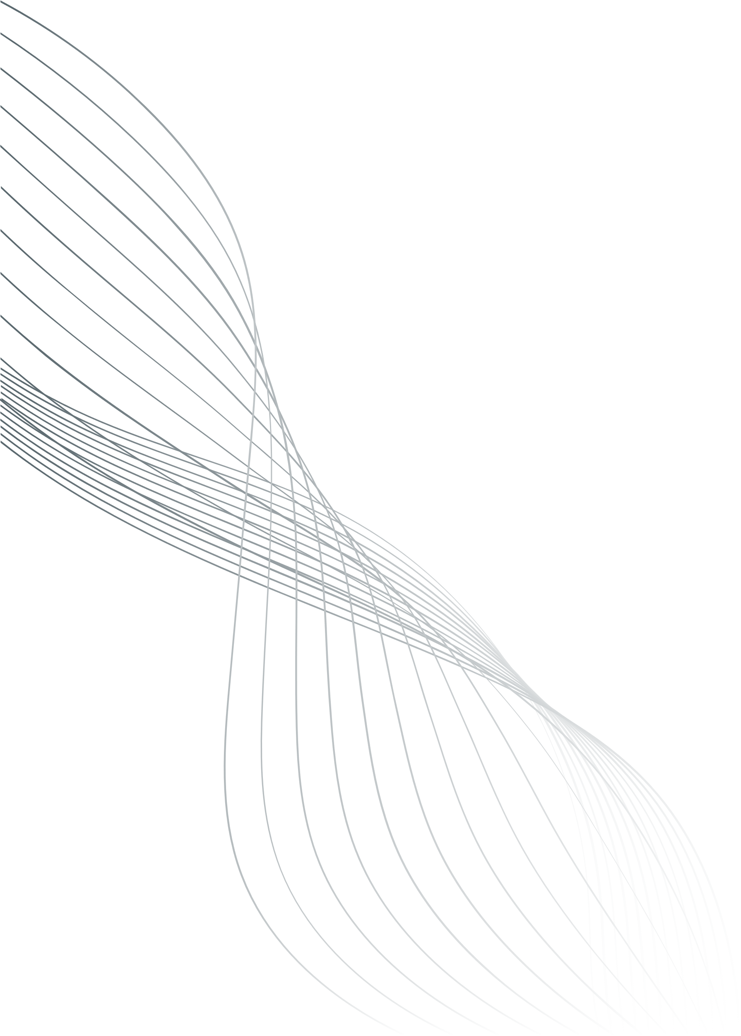
THANK YOU

